Slide 5

In mathematics and the arts, two quantities are in the golden ratio if the ratio between the sum of those quantities and the larger one is the same as the ratio between the larger one and the smaller.
The golden ratio is a mathematical constant approximately 1.6180339887.
The golden ratio is also known as the most aesthetic ratio between the two sides of a rectangle.
The golden ratio is often denoted by the Greek letter (phi). .

Slide 6
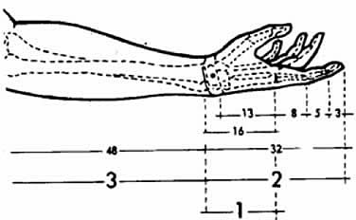
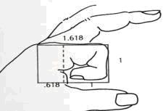
Golden Ratio in Human Hand and Arm
Look at your own hand:
You have ...
2 hands each of which has ...
5 fingers, each of which has ...
3 parts separated by ...
2 knuckles
The length of different parts in your arm also fits the golden ratio.

Slide 7
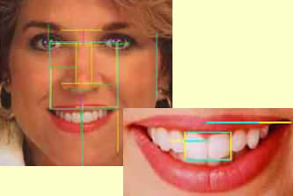
Golden Ratio in the Human Face
The dividence of every long line to the short line equals the golden ratio.
Lenght of the face / Wideness of the face
Lenght between the lips and eyebrows / Lenght of the nose,
Lenght of the face / Lenght between the jaw and eyebrows
Lenght of the mouth / Wideness of the nose,
Wideness of the nose / Distance between the holes of the nose,
Length between the pupils / Length between teh eyebrows.
All contain the golden ratio.

Slide 8
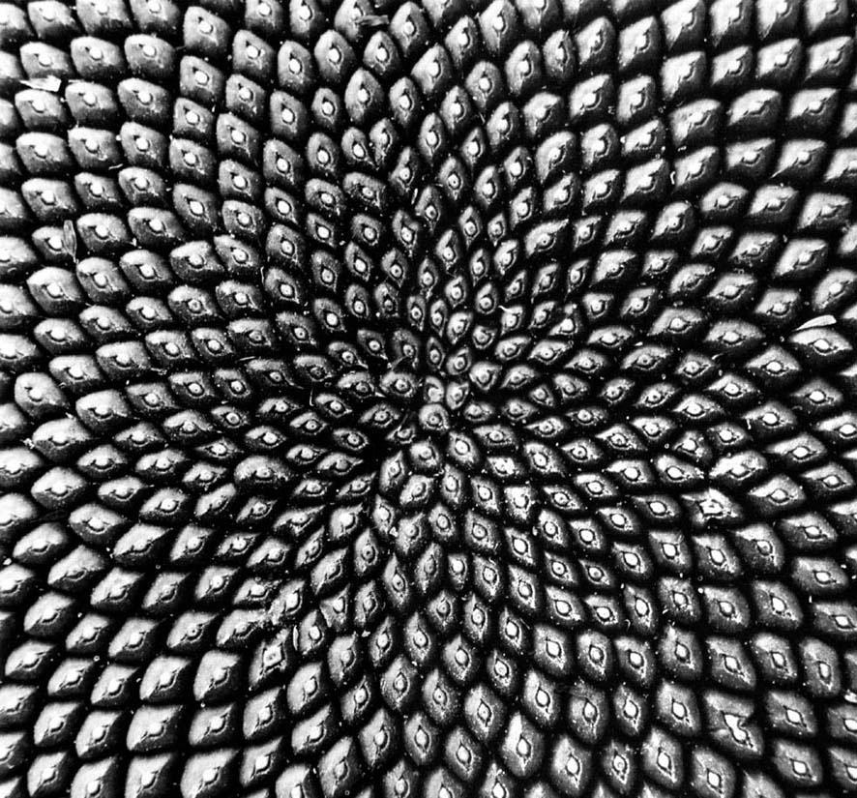
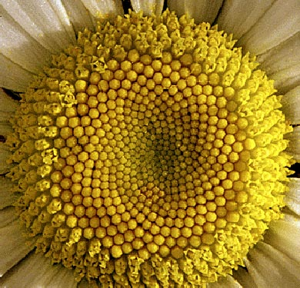
The Golden Spiral can be seen in the arrangement of seeds on flower heads.

Slide 9
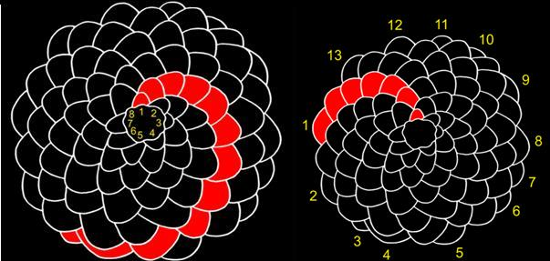

Slide 10
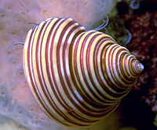
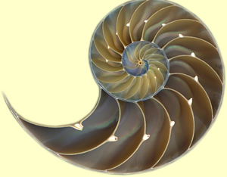
Golden Ratio In The Sea Shells
The shape of the inner and outer surfaces of the sea shells, and their curves fit the golden ratio..

Slide 11
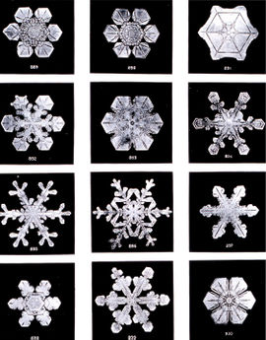
Golden Ratio In the Snowflakes
The ratio of the braches of a snowflake results in the golden ratio.

Slide 13
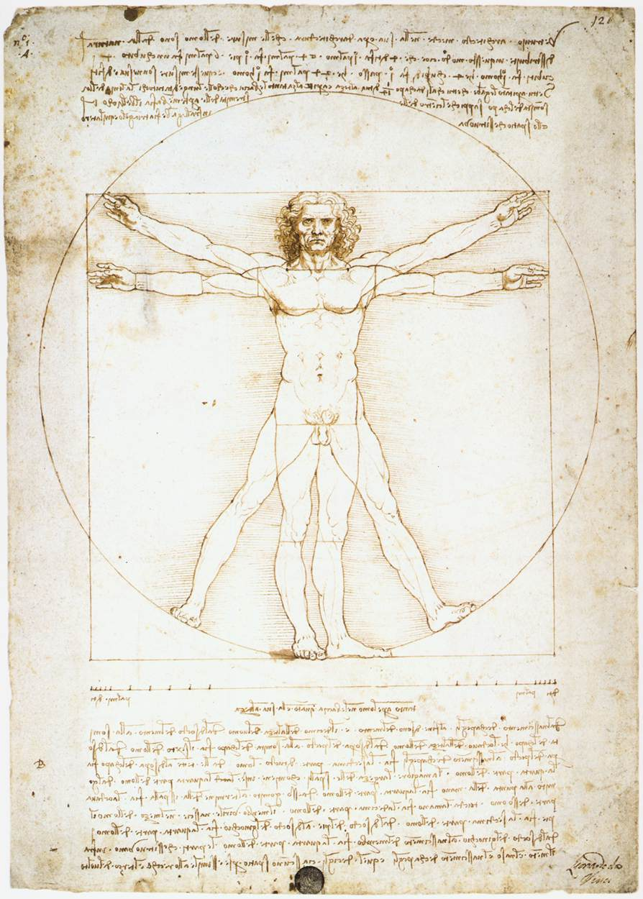
The “Vitruvian Man”
Leonardo did an entire exploration of the human body and the ratios of the lengths of various body parts. “Vitruvian Man” illustrates that the human body is proportioned according to the Golden Ratio.

Slide 14
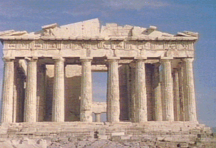
The Parthenon
“Phi“ was named for the Greek sculptor Phidias.
The exterior dimensions of the Parthenon in Athens, built in about 440BC, form a perfect golden rectangle.

Slide 15
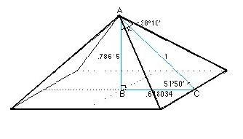
The baselenght of Egyptian pyramids divided by the height of them gives the golden ratio..

Slide 40
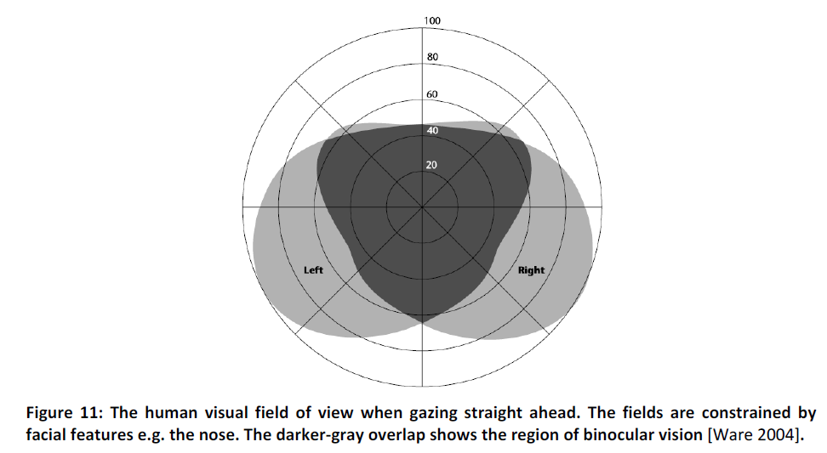

Slide 41
Praveen K. Bandela, PremNandhini Satgunam, Prashant Garg and Shrikant R. Bharadwaj: Corneal Transplantation in Disease Affecting Only One Eye: Does It Make a Difference to Habitual Binocular Viewing?, PLoS ONE (2016) 11(3): e0150118. doi:10.1371/journal.pone.0150118

Slide 43
Thank you for your attention!
Do you have any questions?

